Slide 1

PRESENTATION
Presented by

Slide 2

Agenda
Introduction
Our Approach
It Is Not What We Thought
The Frustration Gap
The Smoking Gun
The Solution
Conclusion

Slide 3

THE QUALITY-OF-LIFE BLACK BOX
Our goal was to understand Quality of Life. We attacked this problem in two ways: a predictive Supervised model and an explanatory Unsupervised model. What we found is that we've been failing a specific group of patients for a reason we've now uncovered
Our Approach:
We us

Slide 4
WHAT PREDICTS QUALITY-OF-LIFE?
First, a predictive Random Forest model was built to find the key drivers of QoL. The model achieved an R² of 0.489.. This model gave us our first clues. It proved the two most important predictors are
- Patient Satisfaction
- Service Type.
But this gave us a circular problem: to improve QoL, you must 'improve satisfaction.' This isn't an answer; it's a puzzle."

Slide 5
Method for SUPERVISED APPROACH

Slide 6
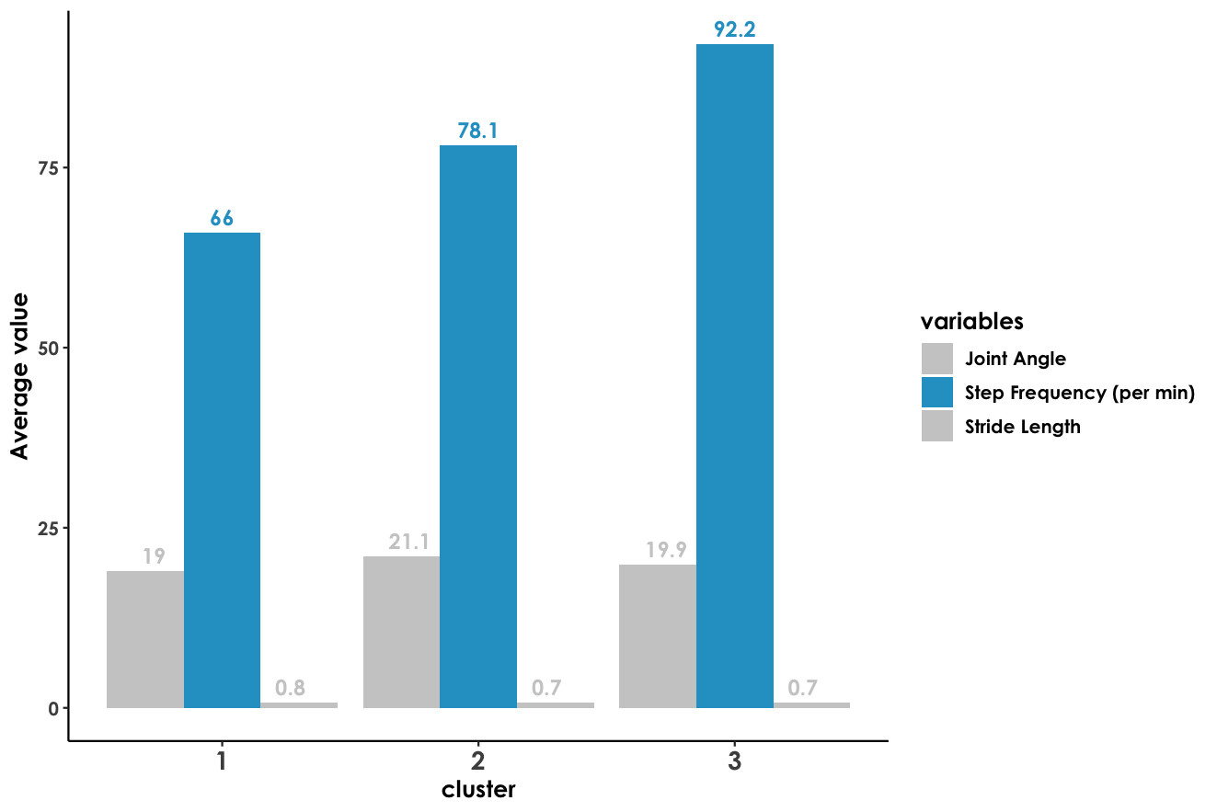
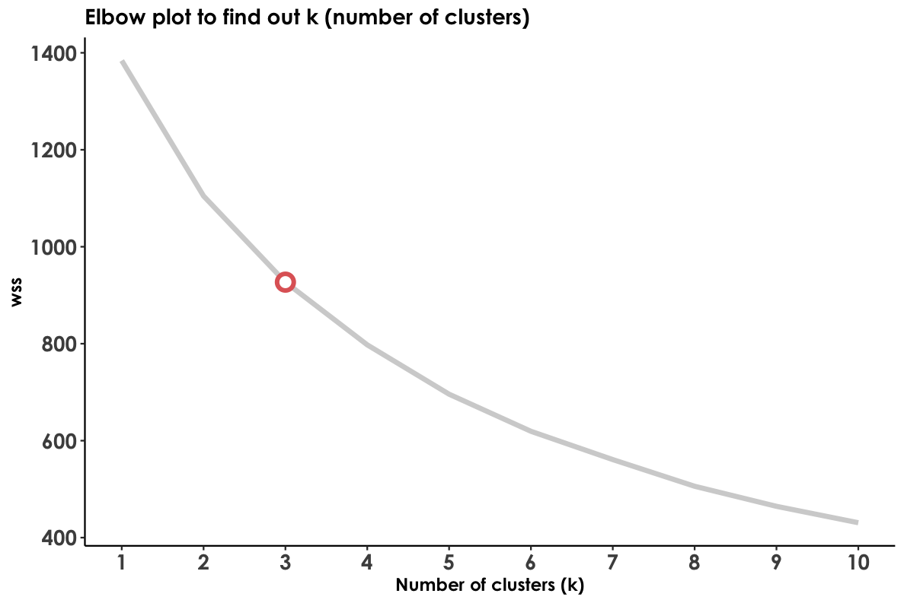
Our Method
Finding the 3 Patient Profiles
3. The Discovery: The model's #1 sorting factor was Step Frequency (Walking Speed).
4. The Profiles: This automatically sorted all patients into three distinct, data-driven groups:
Cluster 1: "Slow Walkers"
Cluster 2: "Steady Walkers”
Cluster 3: "Fast Walkers"
The Method: We used an unsupervised k-Means model to find natural groups in the patient's "movement DNA" (the 4 biomechanical variables).
The "Elbow": The Elbow Plot clearly showed k=3 was the optimal number of clusters, confirming our 3-group model.

Slide 7
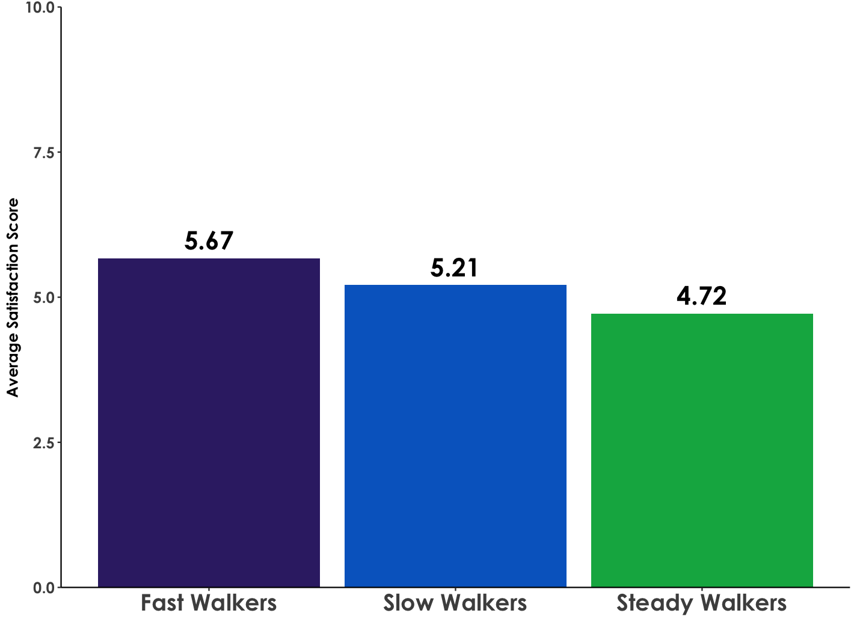
Who Are These Unsatisfied Patients?
To solve the puzzle, we ran an unsupervised k-Means model to find the hidden patient profiles.
We found 3 distinct groups based on walking speed: 'Slow,' 'Steady,' and 'Fast Walkers’.”
Key Insight: This model immediately found the problem group. On this Patient Satisfaction chart, you can see the 'Frustration Gap’, our 'Steady Walkers' (Cluster 2) are the least satisfied group."

Slide 8
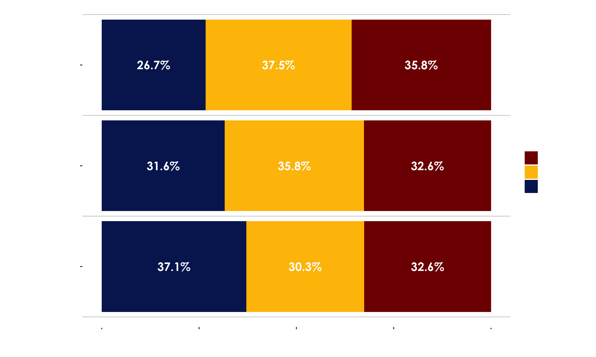
The Smoking Gun
We've now identified the who (the 'frustrated' Cluster 2) and the what (the problem is Patient Satisfaction and Service Type). This slide shows how they connect
Our 'frustrated' Cluster 2 is the exact group that receives the least 'Rehab' (26.7%). This confirms our models' findings: Service Type is a key predictor, and we've just found the group that's getting the wrong one.

Slide 9
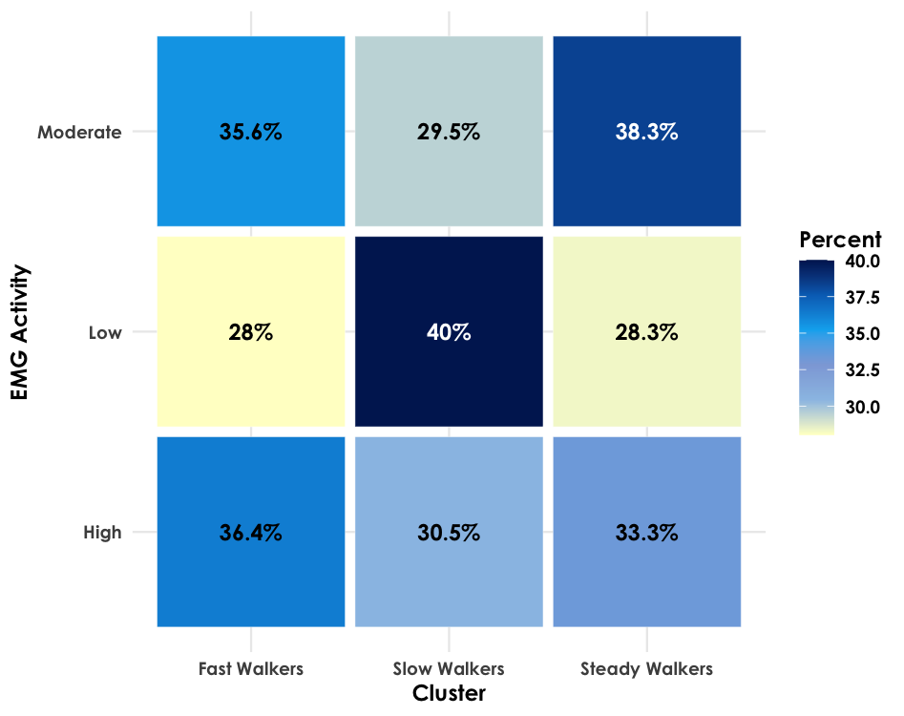
The Solution: A Targeted Triage
We now have a complete picture. We know who is unhappy (Cluster 2) and why (they have a 'Rehab Gap'). Our final piece of analysis, the EMG plot, shows us how to fix it
Our EMG plot proves a 'one-size-fits-all' rehab fails. We can now build a 2-Track Triage System:
Track 1 (Low EMG): Strength Training.
Track 2 (Mod/High EMG): Physical Therapy for pain/balance."

Slide 10

Conclusion
Our Supervised ML model told us to focus on Patient Satisfaction and Service Type (the main drivers of quality-of-life
Our unsupervised k-means clustering model found the 'frustrated' patients and proved they have a 'Rehab Gap.'
Our combined solution is to use our EMG Triage model to give this 'frustrated' group the targeted rehab they need. This will fix the 'Rehab Gap,' which will raise Patient Satisfaction, will ultimately improve Quality of Life.

Slide 11

Q&A

